Slide 1

ACE Account & ACH Refund
Instructions for
Account Set-up

Slide 2
ACE Account & ACH Refund
Relevant to all Trade Account Owners with an associated importer account, effective February 6, 2026, CBP will issue all refunds electronically via Automated Clearing House (ACH) with limited exceptions.
The Automated Commercial Environment (ACE) Portal has been updated to enable electronic refund enrollment, allowing authorized trade users to submit US banking information online and receive funds electronically via ACH.
With an importer sub-account view, ACE Portal Trade Account Owners (TAOs) will have access to the ACH Refund Authorization tab to view, add, and update US banking information necessary for the CBP to issue electronic funds via ACH. This update replaces the manual ACH Refund Enrollment form.
The transition to electronic-only refunds is expected to begin on February 6, 2026, with limited exceptions. All importers are encouraged to set-up their account as soon as possible.

Slide 3
What is ACE
The Automated Commercial Environment Secure Data Portal
Importers use ACE to keep track of their entries, especially if they use multiple brokers
All Brokers use ACE to process entries; most brokers use a 3^{rd-}party APP to interface
Examples of the reports that can be generated by the ACE system:
Duties paid per port
Number of exams
Liquidations

Slide 4
What is an ACH Refund
To gain efficiencies, the CBP directs deposits refunds into Importers’ bank accounts rather than issuing physical checks
If refunds are owed, Importers are required to register for an ACE account to receive monies
The Automated Clearing House (ACH) Refund was recently added to ACE; it’s separate from the “ACH Debit”payment system
There are no charges for an ACE account
Government may use this system for IEEPA refunds, should there be a decision to do so

Slide 5
What you need
A copy of the company information as it exists in the CBP system
Referred to as a “5106” or “Bond Query”, you can obtain this from PMK
Ensure all information is up to date – particularly the email address of the person responsible for the ACE Account
Share this updated information with PMK and any other Brokers you may have
Follow the guide linked here:
ACE Portal - ACH Bank Information for Electronic Refunds

Slide 6
Add PMK International
Once registered and approved, add PMK International to “Notify Party”
Select “Notify Parties” in horizontal navigation bar
Under Notification Type, select “Bills, Refunds, and Notices of Liquidation” or “Bills and Notices” in the drop-down list (as relevant)
Contact accounting@pmkintl.com to request the PMK Employer identification Number (EIN) , then enter it under “Notify Party IR#”
You will get a message saying “Importer Successfully Added PMK as a Notify Party”

Slide 7
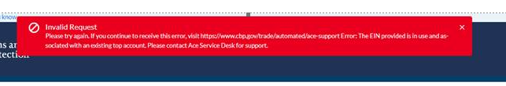
How to Manage Sign-up Errors
If you receive an error message saying “Invalid Request”, ensure you’ve entered the company name and importer record number (IR#) exactly as they appear on the 5106 or Bond Query, then check that you’ve entered a valid business email address
If those are correct, contact PMK for assistance. We will go through the screens together in MS Teams or Zoom (necessary as Broker View is not the same as the Importer View)
If you get an error message stating “EIN Provided is already in use”, someone in your organization, possibly a previous employee, had already registered your company for an ACE account. You will need to ask withing your organization who may have done this, find out who the “Trade Account Owner” is, or send a help request to CBP ACE to change the contact information for the Trade Account Owner ( TAO)

Slide 8
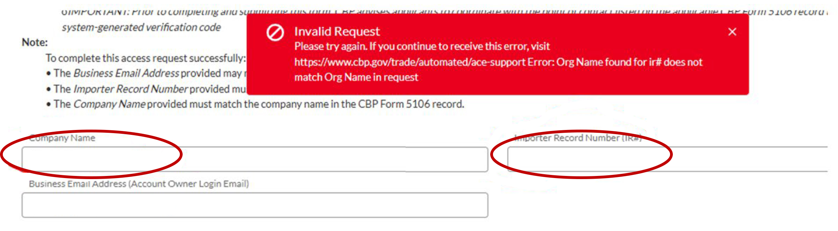

Slide 9
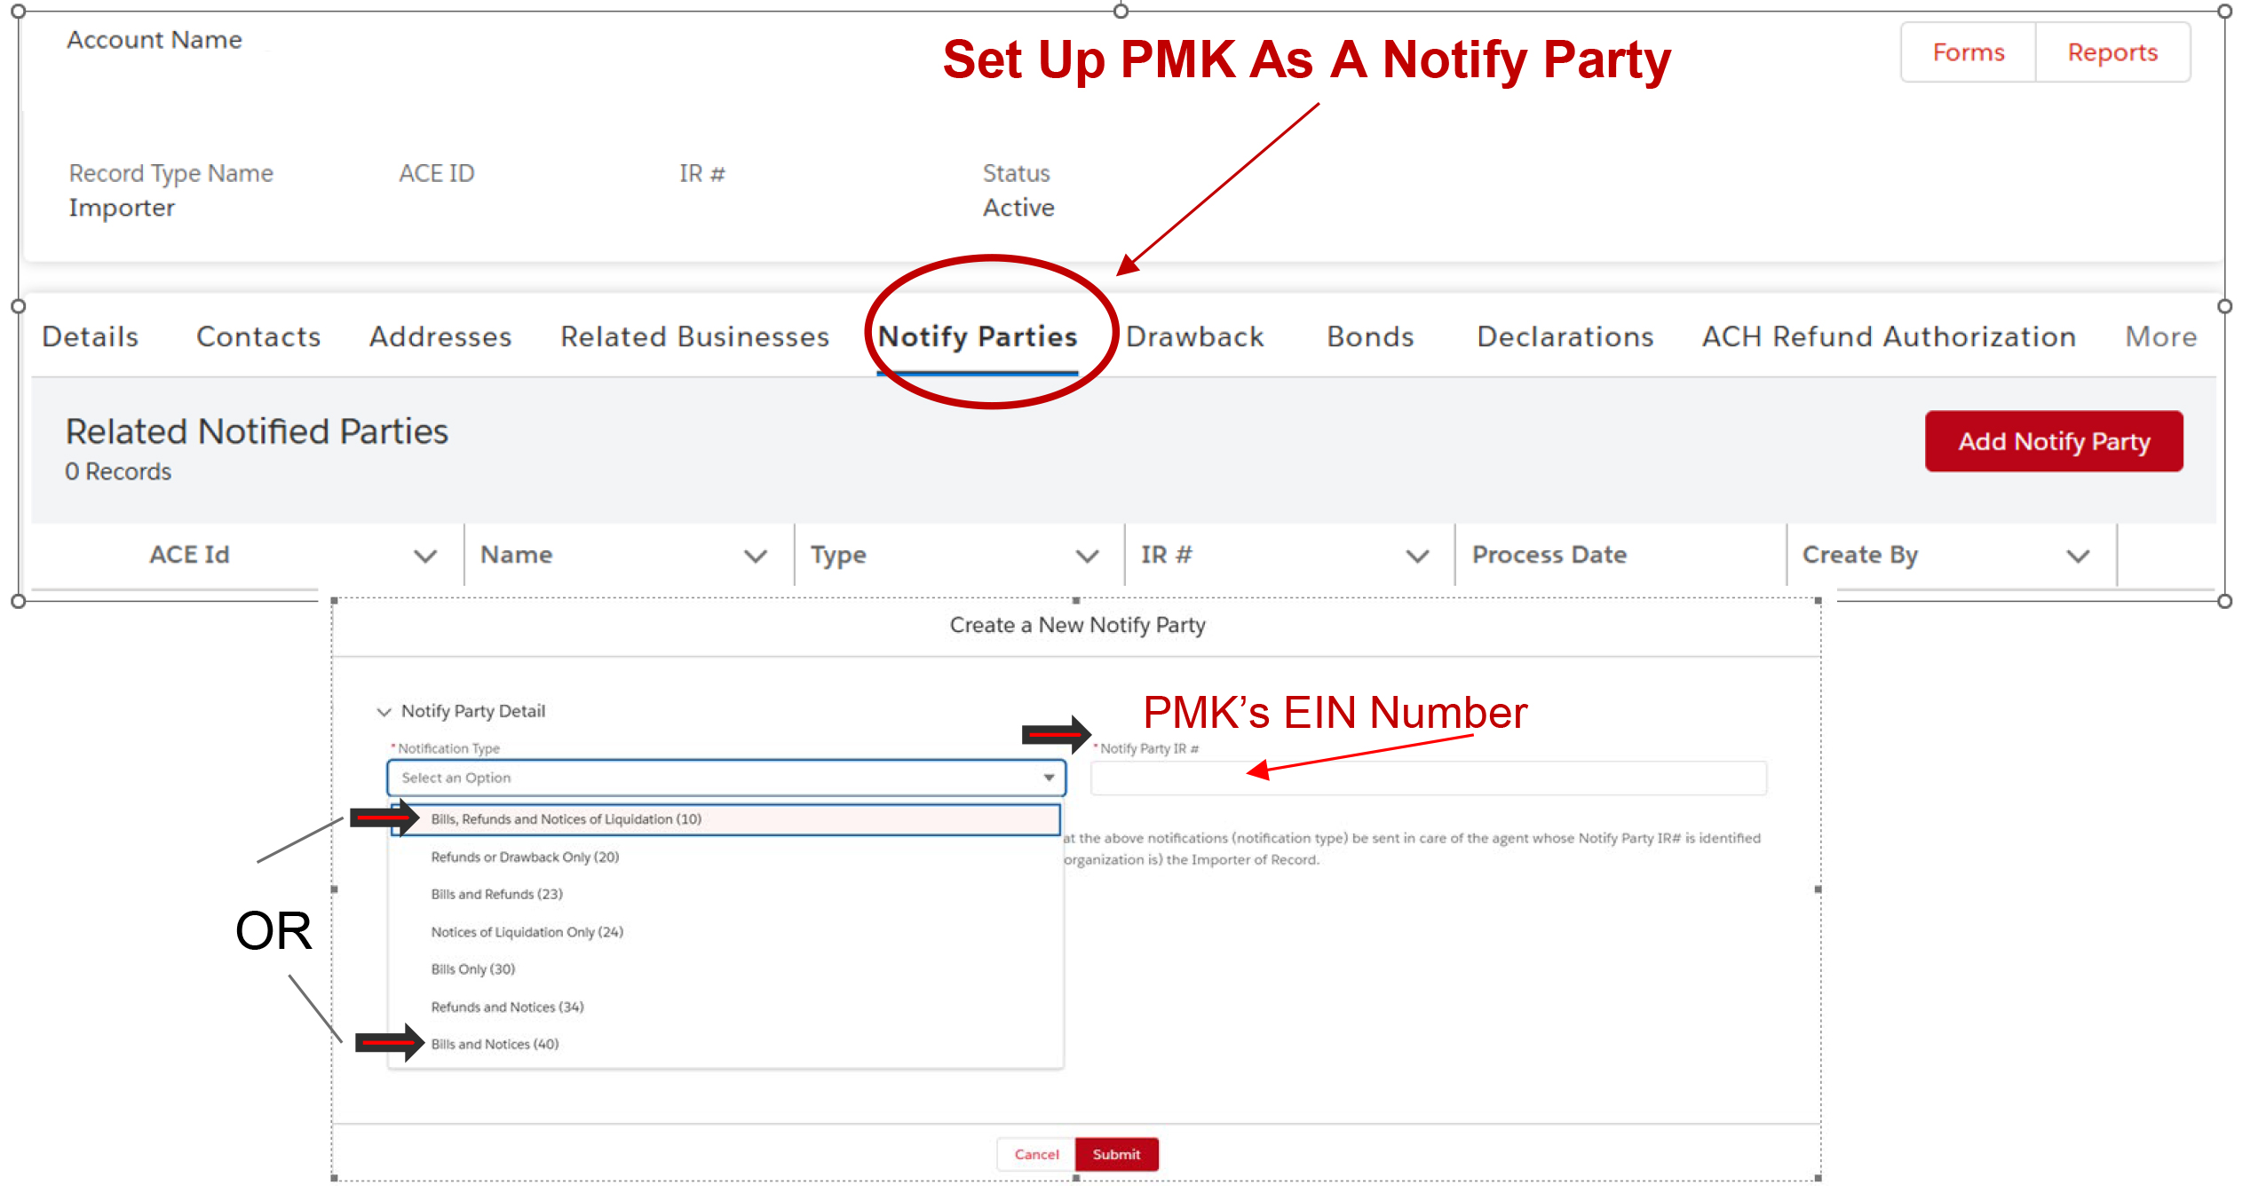
Please contact PMK for EIN

Slide 10
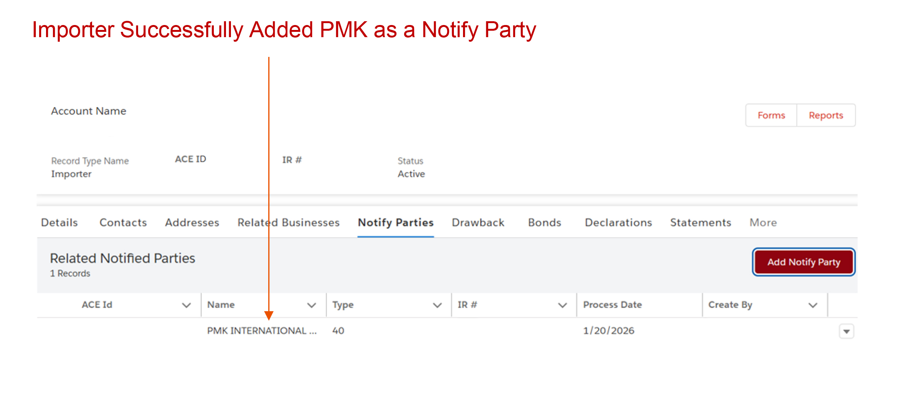

Slide 11
Share Knowledge
Use screen captures and such to document your ACE log-in/Sign-Up Process for others in your company. Although this information is confidential, it needs to be shared with other trusted members of your organization in the case of employee turn-over.

Slide 12
Resources & Contacts
Resources
ACE Portal – ACE Bank Information for Electronic Refunds Guide (US CBP 12.2025 PDF)
ACE Training and Reference Guides ACE Reports Training, ACE Portal Training, and ACE Manifest Training
Support Contact
ACE Portal Support or call 866-530-4172
CBP Refund Support or call 317-298-1200, ext 4015
CBP holds user readiness support calls to help trade participants prepare.

